Slide 1
Threat of entry and debt maturity: Evidence from airlines
Gianpaolo Parise
Presented by Austin Francis

Slide 2
Research Question
Does the threat of entry by low-cost competitors affect financing decisions?

Slide 3
Prior Literature
Deep pocketed firms will attempt to drive financially constrained competitors out of business (Telser, 1966; Bolton and Scharfstein, 1990)
Highly leveraged incumbents are less likely to survive in a competitive environment (Zingales, 1998)

Slide 4
Data Collection
US Department of Transportation Form 41 filings from 1990 to 2014
Compustat North America Fundamentals Annual Files
T-100 Domestic Market Data (flight data)

Slide 5
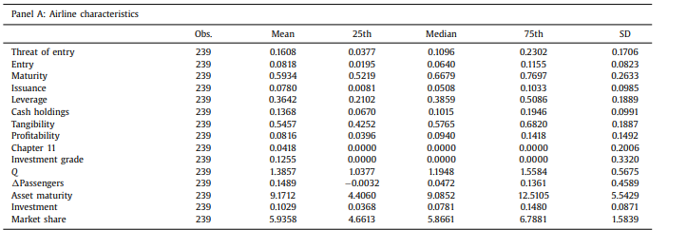
Table 1 – Summary Statistics
Notes:
High variation in threat of entry. 59% of the debt matures in more than three years.

Slide 6
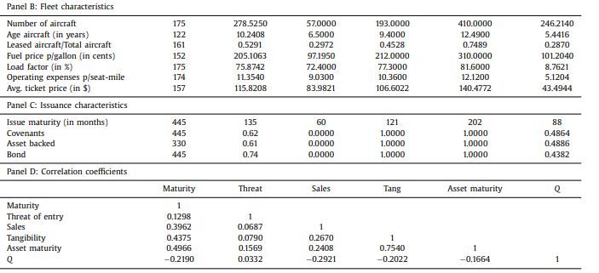
Table 1 – Summary Statistics
Notes:
Threat of entry has low correlation with other metrics (besides asset maturity)

Slide 7
Table 1 Takeaways
On average 59% of the debt matures in more than three years
On average 16% of the incumbent's market is under the threat of entry, but this data is widely skewed
Notes:
Almost 25% of the airline-year pairs in my sample face a negligible threat of entry of less than 4% of their market, while for another 25% of the airline-year pairs more than 23% of the total market is threatened
Debt maturity and Threat of entry display a correlation of 13%. Importantly, Threat of entry exhibits a correlation below 10% with all the other financial variables at the incumbent level (with the only exception being Asset maturity).7 This partially mitigates the concern that Threat of entry might be affected by the characteristics of the incumbent

Slide 8
Empirical Design
Identifies threatened routes as when a low-cost competitor operates on both end points of a route but not the route itself

Slide 9
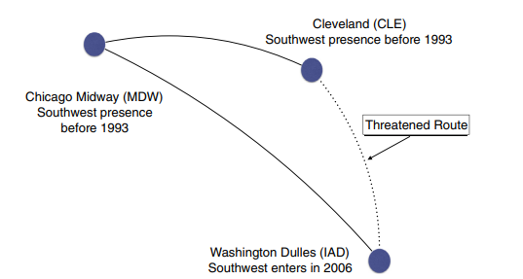
Empirical Design

Slide 10


Empirical Design
Notes:
X = time varying controls Yt and yi are time and airline fixed effect ts

Slide 11
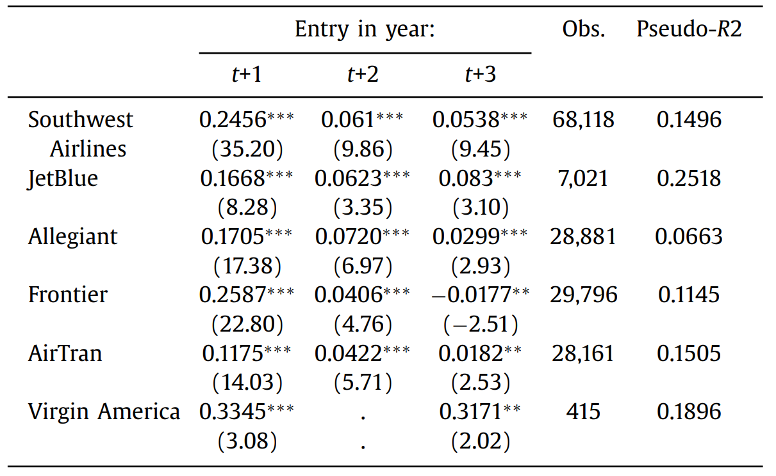
Table 2 - Probability of Entry

Slide 12
Table 2 Takeaways
Low-cost airlines do not expand randomly
The probability of entry increases in year T+1 when an airline is present at both endpoints
Key in identifying which routes are under threat of entry

Slide 13
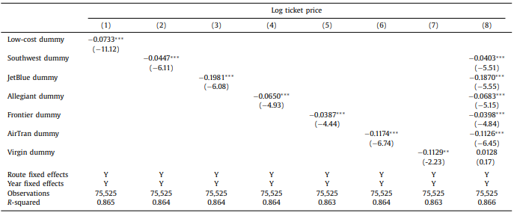
Table 3 Low-cost airlines and route profitability

Slide 14
Table 3 Takeaways
The presence of a low-cost carrier on a route reduces log ticket prices by 7%
This effect varies by carrier
This exerts substantial pressure on incumbents

Slide 15
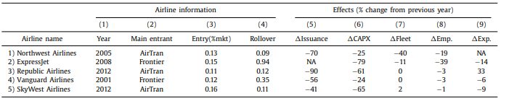
Table 4 – Examples of real effects of rollover risk
Notes:
You can also see an adjustment in fleet size or workforce. These are some picked examples

Slide 16
Table 4 Takeaways
Following a new market entrant, firms reduce their debt issuance
Firms cut capital expenditures, indicating a defensive financial strategy
Notes:
Debt is issued at a lower rate due to the hypothesis that debt becomes more expensive and is rationed.

Slide 17
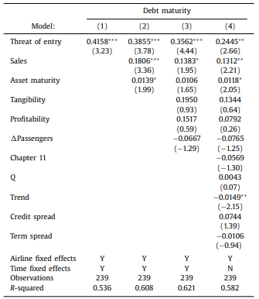
Table 5 – Threat of entry and debt maturity
Notes:
Magnitude of Effect: A one standard deviation increase in the threat of entry is associated with a 6 percentage point increase in the proportion of long-term debt, highlighting the material impact of competitive threats on financial strategy.

Slide 18
Table 5 Takeaways
Significant effect of threat of entry on debt maturity
Airlines likely extend their debt maturity as a defensive measure against competitive threats

Slide 19
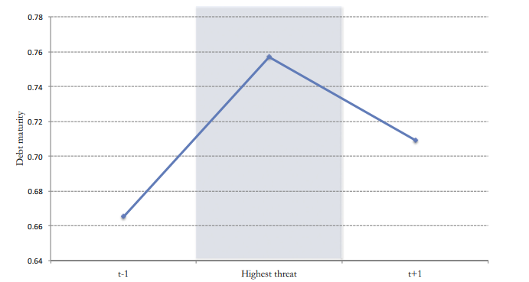
Notes:
This figure illustrates average debt maturity levels in the years around the highest threat exposure for the airlines in my sample. I

Slide 20
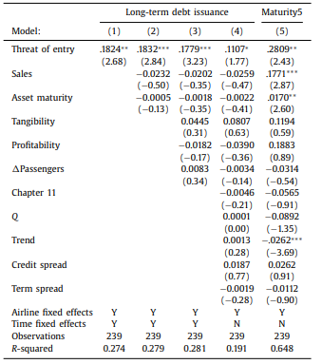
Table 6 – Alternative measures of debt maturity

Slide 21
Table 6 Takeaways
Firms significantly increase their long-term debt issuance following threat of entry
Threatened firms mostly issue debt of maturity longer than five years.

Slide 22
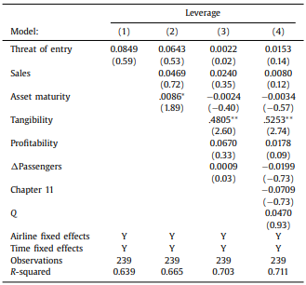
Table 7 – Threat of entry and leverage
Notes:
Book leverage.

Slide 23
Table 7 Takeaways
Threat of entry does not have a significant effect on book leverage
Most of the variation in leverage is driven by time-invariant firm specificities

Slide 24
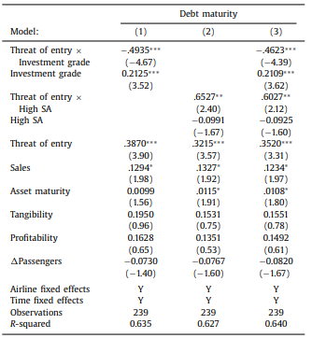
Table 8 – Heterogeneous response to entry threats
Notes:
High SA (hadlock and Pierce, 2010) means financially constrained based on SA index. Investment grade means rating is bbb or higher.

Slide 25
Table 8 Takeaways
Firms with credit ratings of BBB- and higher tend to reduce debt maturity in response to threat of entry
Financially constrained airlines increase debt maturity
Notes:
This suggests that higher-rated airlines are less likely to extend debt maturity when facing competition, possibly because they have more access to alternative financing options and are less vulnerable to rollover risk. This indicates that airlines with fewer financial resources are more likely to extend debt maturity to mitigate rollover risk when threatened by low-cost competitors.

Slide 26
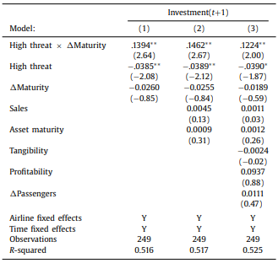
Table 9 – Effects on future investment
Notes:
When airlines increase their debt maturity by one standard deviation, the reduction in future investment is more than halved (from -3.9 to -1.5 percentage points). This suggests that lengthening debt maturity is a crucial strategy for maintaining investment levels in the face of competitive threats.

Slide 27
Table 9 Takeaways
Threatened airlines invest less in the following year
Extending debt maturity mitigates the negative impact

Slide 28
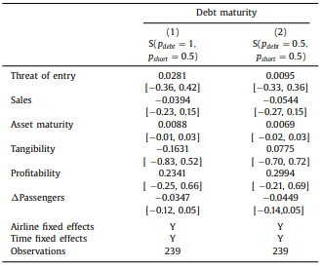
Table 10 – Mechanical Adjustments
Notes:
The table investigates whether the observed relationship between debt maturity and the threat of entry could arise mechanically rather than being driven by strategic decision-making. It uses simulated data to test if similar correlations would emerge by chance.

Slide 29
Table 10 Takeaways
Due to statistical insignificance, any observed relationship in the actual data is unlikely due to random chance
Conclusions are different than actual data

Slide 30
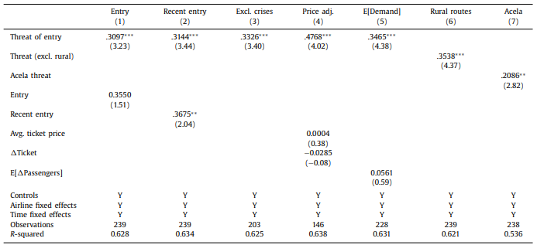
Table 11

Slide 31
Table 11 Takeaways
The relationship between threat of entry and debt maturity is robust across various conditions and controls

Slide 32
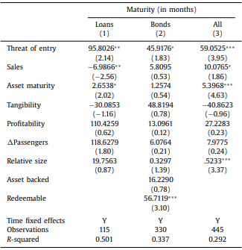
Table 12 – Threat of entry and debt issuance
Notes:
Loans rather than bonds

Slide 33
Table 12 Takeaways
Threatened airlines are more likely to extend their debt maturity through loans rather than bonds
Suggests that lenders are potentially aware of threat of entry and bargain with airlines

Slide 34
Conclusion
Airlines expecting tougher competition from low-cost carriers tend to extend the maturity of their debt
The impact of competition is most pronounced for financially constrained airlines
By extending debt maturity, firms can better withstand competitive pressures
Notes:
This adjustment is primarily driven by a desire to mitigate rollover risk, which becomes more pressing as competition intensifies.

